Slide 1
Dentons Flashpoint
Daily Global Situation Report
January 27, 2021

Slide 2
Global Situation Update: January 27, 2021
KEY TAKEAWAYS
Russia and the US agree to a
clean 5-year renewal of the
New START treaty.
The IMF raised its global growth forecast for 2021, but said it still sees “exceptional uncertainty.”
Global COVID-19 cases surpass
100 million.

Slide 3
Global
Global COVID-19 cases surpassed 100 million and deaths at 2.16 million, with daily new deaths returning to near record high at 17,361.
The UK, as the chair of the G7 for 2020, unveiled plans to set up an institution to assess variants of the coronavirus originating across the world.
Regeneron said that its antibody cocktail prevented symptoms in people whose family members tested positive for COVID-19, functioning as a “passive vaccine.”
The IMF raised its global growth forecast for 2021, but said it still sees “exceptional uncertainty.”
The US and Russia agreed to a clean 5-year renewal of the New START treaty, the last remaining nuclear arms treaty between the two countries, two weeks ahead of its expiration.
A contentious requirement for Japan-specific trials has delayed the rollout of Covid-19 vaccines in Asia’s largest advanced economy and threatened the Tokyo Olympics. Florida offered to replace Tokyo to host the summer Olympics, should coronavirus concerns prompt the Japanese government to cancel the games.
Note: This report is based on sources and information deemed to be true and reliable, but Dentons makes no representations to same.

Slide 4
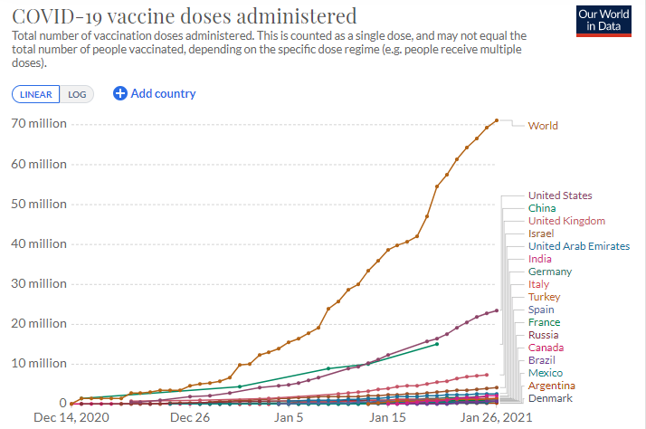
COVID-19 Vaccine
Globally, 71.1 million have received vaccinations.
Share of Population Vaccinated:
Israel: 31.98 percent
UAE: 24.55 percent
UK: 10.1 percent
Bahrain: 8.47 percent
US: 6.01 percent
Spain: 2.5 percent
Italy: 2.15 percent
France: 1.75 percent
Mexico: 0.48 percent

Slide 5
COVID-19 Vaccine
French pharmaceuticals group Sanofi is to help accelerate the production of the BioNTech/Pfizer Covid-19 vaccine and add millions to the EU supply.
A group of Brazilian companies has sought to circumvent the national vaccine plan by buying vaccines directly from producers.
Germany’s health ministry said it cannot confirm local newspaper reports that the AstraZeneca-Oxford vaccine is less effective in people over 65.
China’s Sinopharm said its vaccine is effective against new coronavirus variants.
The WHO issued guidance advising that the Moderna shot be administered in two doses 28 days apart, to be stretched to 42 under exceptional circumstances.
France announced that it will not delay the second dose of Pfizer-BioNTech vaccines to stretch vaccine supplies, as other countries have done.
Note: This report is based on sources and information deemed to be true and reliable, but Dentons makes no representations to same.

Slide 6
How do You Manage Risks?
The coronavirus pandemic has not just added a new layer of risk for business leaders to navigate, but has accelerated drivers of change, including disruptive technologies, political and economic realignments and cultural priorities on equality, justice and conservation, while increasing vulnerabilities that bad actors seek to exploit.
Dentons Intelligence and Security Services Group offers bespoke services to provide business leaders with the intelligence they need to understand and thrive in complex operating environments.
due diligence and compliance investigations
physical and cyber security assessments
country and political risk assessments
enterprise risk management and organizational resiliency advice
crisis and incident response (physical security breaches and cyber incidents, insider threats and reputational impacts)
To learn more about the bespoke intelligence and risk services from Dentons, contact Karl Hopkins.

Slide 7
Markets
Federal Reserve officials are likely to acknowledge recent signs of economic weakening but keep policy on hold at a meeting that concludes Wednesday, choosing to wait and see if business activity picks up.
European stocks slid on Wednesday, weighed down by concerns about a slow economic recovery, while most investors kept to the sidelines ahead of the U.S. Federal Reserve’s policy decision.
Asian equities also slipped on Wednesday as investors looked to the Federal Reserve’s guidance on its monetary policy.
US stocks closed slightly lower Tuesday. A surge in stock trading volume over the past week has put strain on Wall Street’s online brokers. GameStop shares closed 92.7 percent higher, extending a frenzied rise.
Note: This report is based on sources and information deemed to be true and reliable, but Dentons makes no representations to same.

Slide 8
Business
Five major US banks -- Bank of America, JPMorgan Chase, Citigroup, Wells Fargo and US Bancorp -- publicly committed to mandating a diverse set of applicants when hiring.
Work-from-home revenue streams, including PC sales and increased use of cloud storage, boosted Microsoft’s Q4 earnings far higher than expected, sending shares on a surge. Texas Instruments forecast Q1 sales above Wall Street expectations.
US homebuilder DR Horton boosted its full-year outlook on continued strong demand.
Starbucks boosted its full-year profit forecast, partly because of rising Q4 sales, particularly in China.
GE’s Q4 cash flow significantly beat expectations on improving orders in power and renewable energy, allowing the company to return to full year positive cash flow ahead of schedule.
Nissan will cut around 160 office-based jobs in the UK.
Volkswagen is asking the US Supreme Court to overturn a lower-court ruling that would open the auto industry to oversight from local emissions regulators.
A consortium led by state-owned pharma giant Sinopharm plans to take private China Traditional Chinese Medicine Holdings in a deal that would value the firm at least $3.3 billion
Ant Group, the digital payments arm of Chinese ecommerce group Alibaba, is planning to sell its EyeVerify amid heightened tensions between Beijing and Washington over over US user data. EyeVerify is a biometric security company whose technology is used by the banking sector.
Note: This report is based on sources and information deemed to be true and reliable, but Dentons makes no representations to same.

Slide 9
Africa
The African Union called for Kenya and Somalia to
de-escalate tensions along their borders.
Nigerian President Buhari dismissed his military leaders amid pressure to resolve ongoing violence with Boko Haram in the country’s northeast. The Nigerian government extended COVID-19 lockdown measures by four weeks.
The Malian junta that ousted the former president in a coup over the summer was officially dissolved, although its members still partially govern, in a goodwill gesture on the agreed path to general elections.
South African President Ramaphosa denounced “vaccine hoarding” by Western nations at the World Economic Forum.
Note: This report is based on sources and information deemed to be true and reliable, but Dentons makes no representations to same.

Slide 10
Asia
Indonesia surpassed 1 million COVID-19 cases, seeing more than 10,000
daily new cases for most of last week.
China said that the Indian government’s decision to keep a ban on
59 Chinese apps was a violation of the World Trade Organization’s fair
rules of business and would hurt Chinese firms.
Fund managers and bankers leaving Hong Kong for alternative financial
centers have been asked to explain their decision to a range of government
agencies amid concerns that Beijing’s national security law could cause departures
from the Asia finance hub to multiply.
Protests by Indian farmers, which have now been ongoing for two months, escalated Tuesday with
protestors clashing with police on India’s annual Republic Day parade, in which one person was killed and
at least 80 injured.
As lunar new year approaches, Singapore’s central bank is calling on the public to give digital cash gifts in an effort to combat COVID-19 and climate change. A string of key Apple suppliers in China are offering incentives to workers not to go home for the lunar new year, amid fears of possible virus spread.
Note: This report is based on sources and information deemed to be true and reliable, but Dentons makes no representations to same.

Slide 11
Europe
The EU official in charge of post-Brexit oversight warned the UK that its
refusal to grant its ambassador full diplomatic status has raised concerns
in the EU.
Spain’s high profile health minister quit to run in Catalonia’s regional elections.
At the World Economic Forum, French President Macron called for
a “new consensus” on economic policy that would not downplay
the role of the state and public sector like the “Washington consensus.”
France called on the EU to overcome “blockages” to ensure faster disbursement of its €750bn recovery fund to member states, citing the need to re-evaluate eurozone fiscal constraints.
The UK became the first European country to exceed 100,000 confirmed COVID-19 deaths. Portugal posted a record daily death toll of 291. The Dutch government vowed to maintain the COVID-19 curfew despite violent protests. Ireland extended its third national lockdown to March 5 due to continued “enormous” pressure on hospitals. EU’s executive body proposed Monday that the bloc's 27 nations impose more travel restrictions to counter the worrying spread of new coronavirus variants but make sure to keep goods and workers moving across EU borders. Moscow has lifted some measures aimed at slowing the spread of the coronavirus as cases continued to recede over the past week, with daily new infections across Russia dropping below 20,000 for the first time since November 2020.
Note: This report is based on sources and information deemed to be true and reliable, but Dentons makes no representations to same.

Slide 12
Middle East
The US announced that it will restore relations with the
Palestinians and renew aid to refugees and reiterated its
support for a two-state solution.
Israel’s health minister said there have been no serious cases
of COVD-19 among the roughly 6 percent of the population who
have received both vaccine doses.
Libyan protesters clashed with police in Tripoli over an overnight
curfew meant to curb coronavirus transmission.
Iran threatened to block short-notice inspections of its nuclear facilities by the IAEA, calling on the US to end economic sanctions before it returns to compliance with inspections as part of the JCPOA. Israel’s top general said that its military was refreshing its operational plans against Iran and that any US return to a 2015 nuclear accord with Tehran would be “wrong.”
Note: This report is based on sources and information deemed to be true and reliable, but Dentons makes no representations to same.

Slide 13
Americas
Canada announced that it will soon unveil new restrictions on foreign travel.
Ecuadorian healthcare workers reported that vaccines are being administered
to people who are not frontline responders, accusing the health minister of
improperly prioritizing higher-level professionals and wealthy recipients.
Colombia’s defense minister Carlos Homes died from COVID-19 complications.
Peru surpassed 40,000 deaths, the fifth highest death toll in South America.
A Reuters poll of economists shows that Mexico’s GDP likely shrunk 8.8 percent in 2020.
Argentina’s economic activity fell 3.7 percent in November 2020 compared to 2019.
Note: This report is based on sources and information deemed to be true and reliable, but Dentons makes no representations to same.

Slide 14
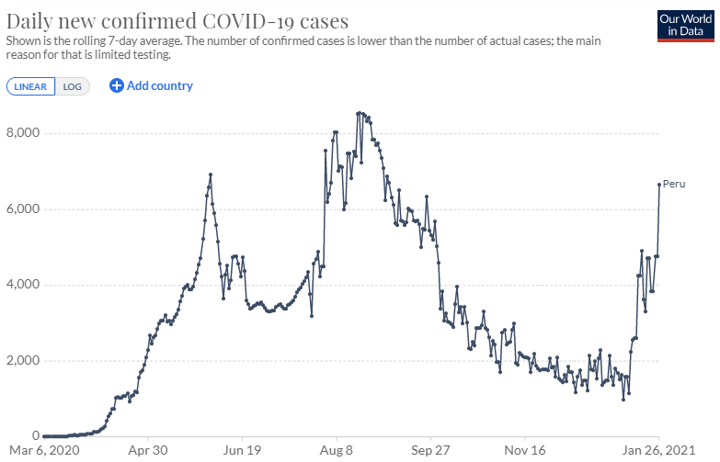
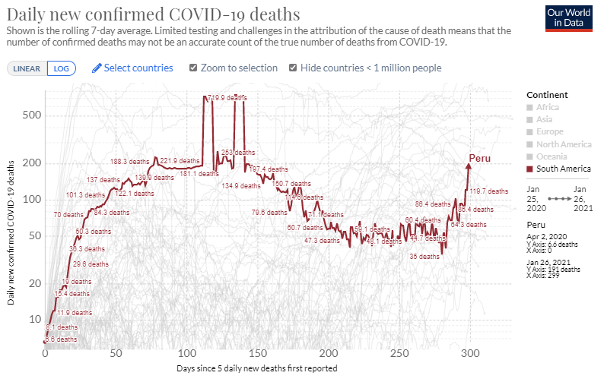
Americas
Peru is experiencing a third wave of coronavirus infections. President Francisco Sagasti announced a total lockdown of the capital and nine other regions, with hospitals reportedly close to collapse. The government has banned flights coming from Europe and Brazil in a bid to curb new, more contagious strains of the virus. Peru has yet to roll out vaccines, but has on order 38 million doses of Sinopharm’s and 14 million doses AstraZeneca’s vaccine. Peru has a population of 32.5 million.
Source: The COVID Tracking Project
Source: Johns Hopkins University

Slide 15
Americas: US
The US aims to acquire an additional 200 million doses of COVID-19 vaccines, enough to inoculate most
Americans by summertime, per President Biden. Across the nation, 19.9 million Americans have received
one or more doses of vaccine. New York City Mayor de Blasio called on pharmaceutical manufacturers to
let other companies make their COVID-19 vaccines to ramp up production. A CDC report found that spread
of COVID-19 in schools is limited when safety protocols are followed but recommended that schools should
curb indoor sports programs. Nationally, hospitalizations continued to decline, now at the lowest level in six weeks.
An effort lead by Sen. Paul (R-KY) to dismiss impeachment charges against President Trump was defeated with the support of 5 Republicans.
President Biden issued four executive orders addressing racial justice, including one focused on combating hate crimes against Asian-Americans. Biden is expected to issue an executive order today suspending new oil and gas leasing on federal land.
The IMF said President Biden’s stimulus plan could boost US output by 5 percent over the next three years.
President Biden warned that the US would respond to any “malign” actions by Russia in his first call with President Putin. Commerce secretary nominee Gina Raimondo pledged a tough line against trade and technology threats from China in her confirmation hearing.
Note: This report is based on sources and information deemed to be true and reliable, but Dentons makes no representations to same.

Slide 16
Science Under the Scope: The Challenges of Vaccine Distribution
Contributed by the Scowcroft Institute of International Affairs
The announcement that the Pfizer vaccine had received FDA authorization was a substantial accomplishment in the fight against the COVID-19 pandemic. Not only that but it was a notable scientific accomplishment as well. Never before had a vaccine been developed in such a short period of time. In the months since this initial announcement, however, discussions of the failures or missteps in vaccine distribution have drowned out the previous excitement.
Frustration surrounding vaccine distribution runs along two lines. The first is the vaccine shortages that are occurring in cities and towns all over the United States. The second is concern over the equitable distribution of the vaccine across the globe. Regarding the first concern, state health officials have openly criticized the Trump Administration and Operation Warp Speed on the week-by-week and last minute vaccine allocation data. One article stated, “State health officials say the unpredictable shipments have led to chaos on the ground, including the inability to quickly use up the doses sent to them.”(1) The unpredictable federal allocation of doses was especially bad during the first several weeks of distribution, but have since appeared to stabilize.(2) Unfortunately, this has not translated to the state-level, where many health officials say they still do not know how many doses to expect each week.
This week, concerns about the inconsistency of vaccine allocation amplified as a number of cities across the country said they would run out of vaccines before the end of the week if they did not get further supplies.(3) Some cities such as New York and San Francisco worried they would have to cancel vaccine appointments, while a county in North Carolina turned people away from their vaccine clinic because they ran out of doses.(4) With President Biden now in office, officials are looking to the new administration to provide more predictable vaccine allocation, which would allow them to develop a comprehensive campaign. Thus far, the Biden Administration has already pledged to communicate better with states, and will deliver 10 million doses per week for the next three weeks.
The second vaccine distribution challenge, as mentioned earlier, is concern over the equitable distribution of the vaccine. On January
Note: This report is based on sources and information deemed to be true and reliable, but Dentons makes no representations to same.

Slide 17
Science Under the Scope: The Challenges of Vaccine Distribution
18th, Dr. Tedros from the World Health Organization made the statement that the world was on the brink of a “catastrophic moral failure.”(5) He pointed out that 39 million doses of vaccine have gone to the richest fifty countries, but only 25 have gone to the one lowest income country.(6) Dr. Tedros and the WHO’s argument is that “vaccinationalism” is putting the poorest and most vulnerable people around the world at great risk.
A recent study conducted by Duke Global Health Innovation Center found that most people in low-income countries will likely have to wait until 2023 or 2024 to receive the COVID-19 vaccine.(7) Additionally, almost all low- and middle-income countries must rely on donations for COVAX to get doses of the vaccine. Over the course of 2021, vaccine manufacturers predict that they will be able to make 10 billion doses of vaccine available.(8) Of those 10 billion doses, approximately half has already been ordered by the 27 member states of the European Union and 5 other wealthy countries. Canada, for example, has pre-ordered the equivalent of 9 doses per person for their entire population.(9)
Global public health leaders and other humanitarian leaders stress that the inequitable distribution of the COVID-19 vaccine is not only moral failure, but it also threatens our ability to bring the pandemic to an end.
References
(1) Chen, C., Arnsdorf, I, and Gabrielson, R. (2021, January 19). How Operation Warp Speed Created Vaccination Chaos. ProPublica. https://www.propublica.org/article/how-operation-warp-speed-created-vaccination-chaos?utm_source=sailthru&utm_medium=email&utm_campaign=majorinvestigations&utm_content=feature
(2) Chen, C., Arnsdorf, I, and Gabrielson, R. (2021, January 19). How Operation Warp Speed Created Vaccination Chaos. ProPublica. https://www.propublica.org/article/how-operation-warp-speed-created-vaccination-chaos?utm_source=sailthru&utm_medium=email&utm_campaign=majorinvestigations&utm_content=feature
(3) Kim, S. (2021, January 20). These Places Are Running Out of COVID Vaccines in the U.S. -- From New York to San Francisco. Newsweek. https://www.newsweek.com/running-out-covid-vaccines-us-new-york-san-francisco-1562944
(4) Kim, S. (2021, January 20). These Places Are Running Out of COVID Vaccines in the U.S. -- From New York to San Francisco. Newsweek. https://www.newsweek.com/running-out-covid-vaccines-us-new-york-san-francisco-1562944
(5) (2021, January 18). WHO chief warns against ‘catastrophic moral failure’ in COVID-19 vaccine access. UN News. https://news.un.org/en/story/2021/01/1082362
(6) (2021, January 18). WHO chief warns against ‘catastrophic moral failure’ in COVID-19 vaccine access. UN News. https://news.un.org/en/story/2021/01/1082362
(7) Mullard, A. (2020, November 30). How COVID vaccines are being divvied up around the world. Nature. https://www.nature.com/articles/d41586-020-03370-6
(8) Mullard, A. (2020, November 30). How COVID vaccines are being divvied up around the world. Nature. https://www.nature.com/articles/d41586-020-03370-6
(9) Mullard, A. (2020, November 30). How COVID vaccines are being divvied up around the world. Nature. https://www.nature.com/articles/d41586-020-03370-6
Note: This report is based on sources and information deemed to be true and reliable, but Dentons makes no representations to same.

Slide 18
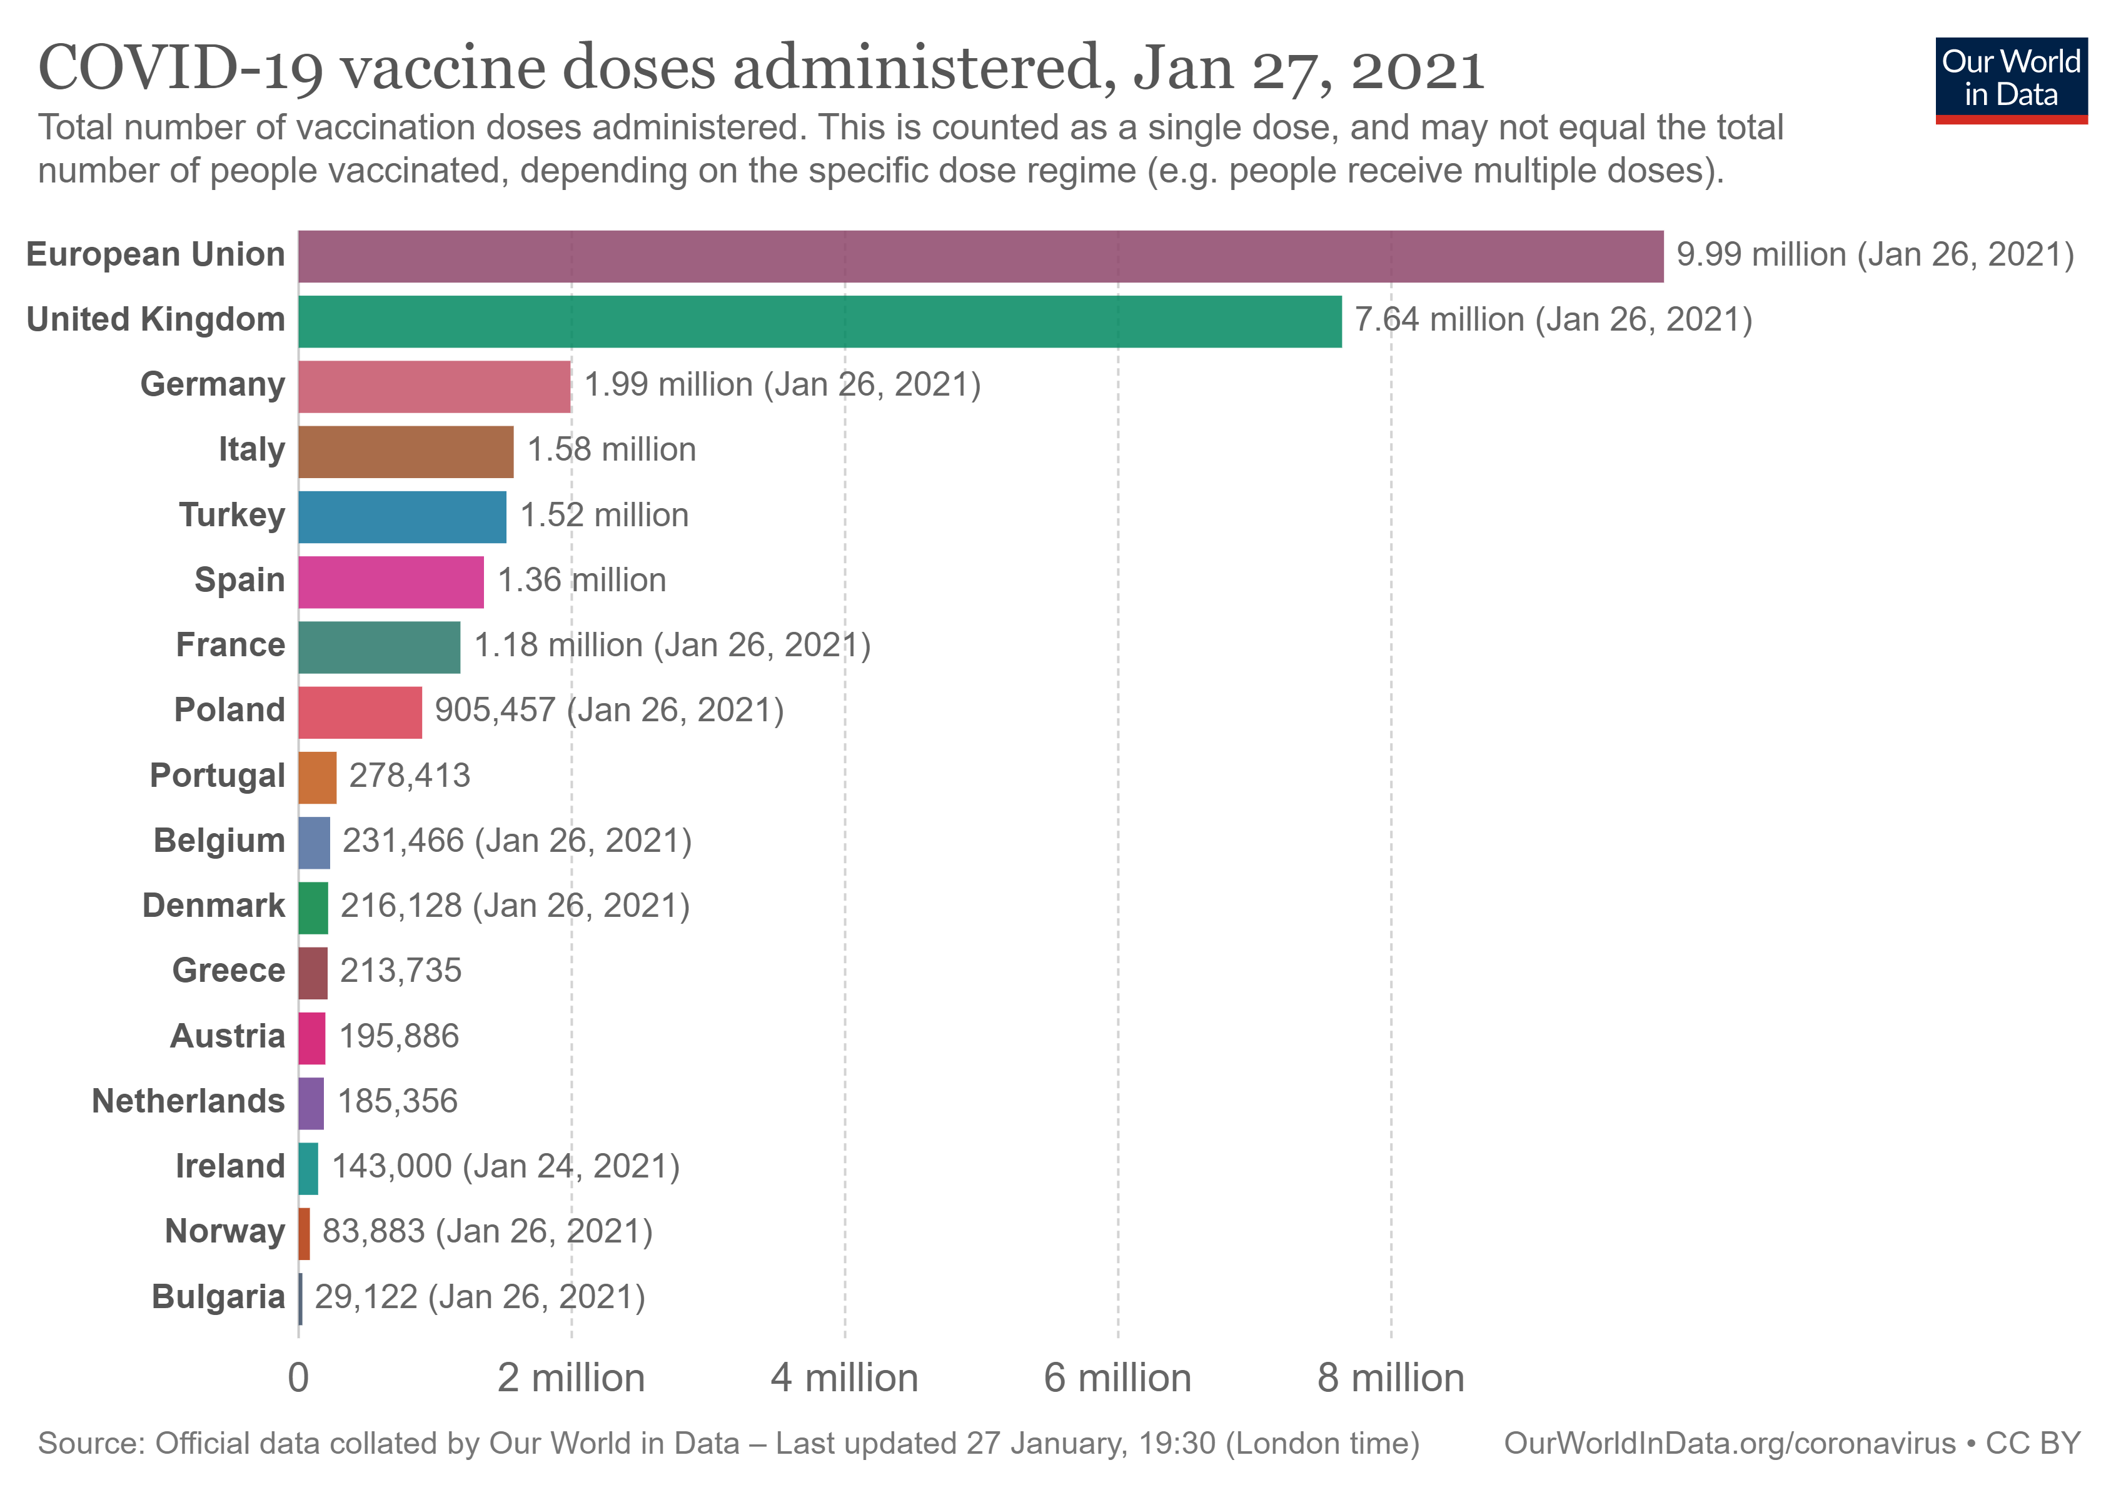
Region in Charts: Europe
Europe continues to struggle with lockdowns, outbreaks, and new strains of the coronavirus. Over the past few days, Portuguese hospitals have struggled under virus loads, the UK has shown hesitancy to reopen, and the Netherlands have faced down violent anti-lockdown protests. In this tense atmosphere, vaccine distribution has become an increasingly pressing issue - and one that promises to cause political disputes across the region. The EU is preparing export controls for coronavirus vaccines and has been in conflict with AstraZeneca over delays in delivery of doses, even demanding the company redirect vaccines from UK factories.
Note: This report is based on sources and information deemed to be true and reliable, but Dentons makes no representations to same.

Slide 19
Coronavirus Condition Updates
As of 2100 hours US EDT on January 26, 2021

Slide 20
Confirmed Cases (New)
Europe
33,568,959 (193,232)
Eastern Med
5,551,368 (25,531)
Western Pacific
1,351,280 (9,364)
Americas
44,573,030 (282,161)
Southeast Asia
12,733,991 (27,912)
Africa
2,495,315 (14,192)
Cruise Ships
721 (0)
Global: 100,274,664 (552,392)
Reflects data as of 2100 hours the evening before the date of the situation report.
Data Source: Johns Hopkins University

Slide 21
Total Deaths (New)
Europe
722,114 (6,819)
Eastern Med
132,003 (480)
Western Pacific
23,592 (219)
Americas
1,024,316 (8,525)
Southeast Asia
195,761 (507)
Africa
59,645 (811)
Cruise Ships
15 (0)
Global: 2,157,446 (17,361)
Reflects data as of 2100 hours the evening before the date of the situation report.
Data Source: Johns Hopkins University

Slide 22
Active Cases
Europe
14,439,712 (39,847)
Eastern Med
502,678 (1,649)
Western Pacific
152,051 (-6,858)
Americas
16,717,169 (101,414)
Southeast Asia
416,880 (1,058)
Africa
327,152 (-6,388)
Cruise Ships
0 (0)
Global: 32,555,642 (130,722)
Reflects data as of 2100 hours the evening before the date of the situation report.
Data Source: Johns Hopkins University

Slide 23
Country Risk Assessment
VERY HIGH RISK (>5,000 cases)
VERY HIGH RISK (>5,000 cases)
Country | Active Cases | Confirmed (New) | Deaths (New) | Cases/ 1M Pop. | Deaths/ 1M Pop | % Daily Change7-Day Av
US | 14844678 | 25443699 (146640) | 425216 (4087) | 78320 | 1311 | 4.70%
UK | 3590749 | 3700268 (20167) | 100359 (1636) | 54189 | 1471 | 6.04%
France | 2838981 | 3138498 (22143) | 74250 (614) | 47125 | 1134 | 4.52%
Spain | 2422647 | 2629817 (36435) | 56794 (586) | 58457 | 1215 | 9.85%
Netherlands | 943802 | 970156 (3962) | 13772 (86) | 55772 | 796 | 3.67%
Brazil | 818188 | 8933356 (61963) | 218878 (1214) | 41873 | 1026 | 4.02%
Belgium | 675763 | 696642 (1784) | 20879 (65) | 59806 | 1791 | 2.21%
Sweden | 545042 | 556289 (9123) | 11247 (242) | 54886 | 1110 | 4.14%
Russia | 505907 | 3716228 (17982) | 69391 (550) | 25738 | 483 | 3.82%
Italy | 482417 | 2485956 (10584) | 86422 (541) | 41151 | 1431 | 3.43%
Serbia | 383282 | 387206 (2080) | 3924 (19) | 44419 | 450 | 2.95%
Mexico | 288229 | 1788905 (17165) | 152016 (1743) | 13660 | 1159 | 6.74%
Germany | 228491 | 2164043 (9387) | 53619 (492) | 25771 | 648 | 4.27%
Ukraine | 215196 | 1237810 (3038) | 23148 (147) | 27468 | 506 | 2.56%
Country | Active Cases | Confirmed (New) | Deaths (New) | Cases/ 1M Pop. | Deaths/ 1M Pop | % Daily Change7-Day Av
Poland | 203482 | 1482722 (4603) | 35665 (264) | 39202 | 943 | 2.62%
Switzerland | 188679 | 515483 (1884) | 9204 (58) | 59313 | 1059 | 2.58%
India | 176498 | 10689527 (12689) | 153724 (137) | 7703 | 111 | 0.88%
Portugal | 167381 | 653878 (10765) | 11012 (291) | 64234 | 1082 | 13.29%
Indonesia | 163526 | 1012350 (13094) | 28468 (336) | 3679 | 103 | 8.39%
Ireland | 163421 | 189851 (928) | 3066 (89) | 38205 | 617 | 6.85%
Argentina | 163402 | 1885210 (10409) | 47253 (219) | 41495 | 1040 | 3.48%
Iran | 150779 | 1385706 (6420) | 57560 (79) | 16378 | 680 | 3.14%
South Africa | 127107 | 1423578 (6041) | 41797 (680) | 23832 | 700 | 4.70%
Colombia | 124320 | 2041352 (13606) | 52128 (381) | 39876 | 1018 | 5.01%
Lebanon | 114528 | 285754 (3505) | 2477 (103) | 41974 | 364 | 8.90%
Hungary | 104083 | 360877 (459) | 12113 (89) | 37411 | 1256 | 2.11%
Czechia | 99934 | 946946 (6942) | 15618 (165) | 88337 | 1466 | 5.01%
Turkey | 94495 | 2442350 (7103) | 25344 (134) | 28782 | 299 | 1.74%
Data Source: Johns Hopkins University
Note: This report is based on sources and information deemed to be true and reliable, but Dentons makes no representations to same.

Slide 24
Country Risk Assessment
VERY HIGH RISK (>5,000 cases)
VERY HIGH RISK (>5,000 cases)
Country | Active Cases | Confirmed (New) | Deaths (New) | Cases/ 1M Pop. | Deaths/ 1M Pop | % Daily Change7-Day Av
Honduras | 78797 | 142880 (896) | 3486 (24) | 14207 | 346 | 4.77%
Israel | 76938 | 617168 (3828) | 4513 (15) | 66711 | 491 | 8.35%
Japan | 65863 | 372545 (3861) | 5298 (105) | 2916 | 41 | 8.47%
Canada | 57899 | 761697 (4040) | 18981 (113) | 19958 | 512 | 4.87%
Dominican Republic | 53929 | 206305 (1143) | 2564 (19) | 18910 | 235 | 4.71%
Greece | 53770 | 153226 (814) | 5692 (21) | 14742 | 548 | 2.46%
Lithuania | 53339 | 177934 (768) | 2688 (24) | 65894 | 995 | 5.19%
Bangladesh | 47435 | 532916 (515) | 8055 (14) | 3218 | 49 | 0.73%
Tunisia | 45297 | 200662 (2026) | 6370 (83) | 16878 | 536 | 8.06%
Panama | 45202 | 313834 (1676) | 5137 (39) | 72089 | 1180 | 3.92%
Peru | 44396 | 1107239 (13301) | 40107 (499) | 33317 | 1207 | 4.22%
Norway | 43046 | 61594 (279) | 550 (2) | 11311 | 101 | 3.47%
Bolivia | 42548 | 205208 (2390) | 10105 (54) | 17241 | 854 | 6.88%
Malaysia | 40574 | 190434 (3585) | 700 (11) | 5841 | 21 | 13.16%
Country | Active Cases | Confirmed (New) | Deaths (New) | Cases/ 1M Pop | Deaths/ 1M Pop | % Daily Change7-Day Av
Costa Rica | 38970 | 191345 (600) | 2567 (9) | 37367 | 501 | 2.34%
Romania | 38905 | 715438 (2877) | 17938 (97) | 37333 | 936 | 2.45%
Slovakia | 37166 | 238617 (1590) | 4260 (192) | 43693 | 780 | 5.16%
Pakistan | 33820 | 537477 (1563) | 11450 (74) | 2400 | 51 | 2.36%
Algeria | 30890 | 106097 (243) | 2871 (5) | 2395 | 65 | 1.66%
Philippines | 30357 | 516166 (1170) | 10386 (94) | 4675 | 94 | 2.34%
Cyprus | 28005 | 30252 (109) | 190 (2) | 24952 | 157 | 3.17%
Albania | 27479 | 73691 (879) | 1332 (8) | 25623 | 463 | 6.95%
Kazakhstan | 27153 | 228692 (1527) | 3035 (74) | 9507 | 131 | 4.58%
Egypt | 26629 | 163129 (643) | 9067 (55) | 1577 | 88 | 3.04%
Bulgaria | 26505 | 216416 (827) | 8916 (36) | 31282 | 1289 | 1.61%
Chile | 26017 | 706500 (3322) | 18023 (24) | 36778 | 938 | 4.15%
UAE | 25148 | 285147 (3601) | 805 (7) | 28633 | 81 | 8.74%
Uganda | 24892 | 39261 (73) | 318 (0) | 843 | 7 | 1.85%
Data Source: Johns Hopkins University
Note: This report is based on sources and information deemed to be true and reliable, but Dentons makes no representations to same.

Slide 25
Country Risk Assessment
VERY HIGH RISK (>5,000 cases)
VERY HIGH RISK (>5,000 cases)
Country | Active Cases | Confirmed (New) | Deaths (New) | Cases/ 1M Pop. | Deaths/ 1M Pop | % Daily Change7-Day Av
Nigeria | 23501 | 124299 (1303) | 1522 (15) | 595 | 7 | 8.84%
Ecuador | 23407 | 242146 (579) | 14668 (29) | 13607 | 824 | 3.96%
Bosnia | 22579 | 120532 (389) | 4621 (28) | 36871 | 1414 | 1.78%
Paraguay | 22173 | 129394 (1028) | 2651 (19) | 18015 | 369 | 4.66%
Libya | 19223 | 115299 (870) | 1789 (7) | 16651 | 258 | 4.19%
Slovenia | 18134 | 159812 (1681) | 3406 (27) | 76866 | 1638 | 5.43%
Iraq | 17618 | 615380 (804) | 13010 (10) | 15107 | 319 | 0.90%
Kenya | 14818 | 100193 (141) | 1750 (6) | 1840 | 32 | 0.88%
Austria | 14699 | 407140 (1417) | 7515 (64) | 45058 | 832 | 2.63%
Morocco | 14483 | 467493 (867) | 8187 (15) | 12581 | 220 | 1.31%
Malawi | 13285 | 20830 (843) | 540 (22) | 1073 | 28 | 33.37%
Belarus | 12889 | 239482 (847) | 1668 (10) | 25349 | 177 | 4.50%
Myanmar | 12505 | 138368 (411) | 3082 (13) | 2533 | 56 | 2.26%
Mozambique | 12383 | 34055 (1274) | 329 (-34) | 1073 | 10 | 16.99%
Country | Active Cases | Confirmed (New) | Deaths (New) | Cases/ 1M Pop | Deaths/ 1M Pop | % Daily Change7-Day Av
Latvia | 11763 | 61924 (693) | 1126 (12) | 33041 | 601 | 8.40%
Ethiopia | 11746 | 134569 (437) | 2075 (4) | 1154 | 18 | 2.11%
Denmark | 11506 | 196632 (654) | 2031 (20) | 33761 | 350 | 2.71%
Finland | 11465 | 43120 (348) | 655 (0) | 7775 | 118 | 5.56%
Estonia | 9899 | 41330 (355) | 392 (9) | 31144 | 295 | 8.20%
Guatemala | 9665 | 155459 (1029) | 5486 (17) | 8587 | 303 | 3.33%
South Korea | 9573 | 76429 (554) | 1378 (7) | 1479 | 27 | 3.81%
N Macedonia | 8728 | 91161 (444) | 2812 (21) | 43757 | 1350 | 1.94%
Sri Lanka | 8588 | 59922 (755) | 288 (1) | 2792 | 13 | 9.18%
West Bank & Gaza | 8311 | 156393 (509) | 1803 (7) | 30259 | 349 | 2.11%
Jordan | 7988 | 322241 (943) | 4248 (9) | 31405 | 414 | 1.80%
Armenia | 7776 | 166232 (138) | 3052 (5) | 56038 | 1029 | 0.79%
Montenegro | 7731 | 59262 (565) | 777 (7) | 94349 | 1237 | 5.12%
Zimbabwe | 7488 | 32004 (358) | 1103 (28) | 2136 | 74 | 10.40%
Data Source: Johns Hopkins University
Note: This report is based on sources and information deemed to be true and reliable, but Dentons makes no representations to same.

Slide 26
Country Risk Assessment
VERY HIGH RISK (>5,000 cases)
HIGH RISK (1,000-5,000 cases)
Country | Active Cases | Confirmed (New) | Deaths (New) | Cases/ 1M Pop. | Deaths/ 1M Pop | % Daily Change7-Day Av
Uruguay | 7418 | 38680 (639) | 401 (11) | 11113 | 115 | 13.53%
Georgia | 7280 | 254822 (1006) | 3096 (25) | 63949 | 777 | 2.10%
Zambia | 6588 | 47622 (1476) | 672 (12) | 2550 | 36 | 17.02%
Venezuela | 6581 | 124525 (413) | 1159 (5) | 4386 | 41 | 2.74%
Congo (Kinshasa) | 6419 | 22048 (94) | 661 (0) | 242 | 7 | 4.12%
Moldova | 6211 | 156972 (546) | 3381 (13) | 38965 | 839 | 2.21%
Sudan** | 6092 | 28522 (1996) | 1750 (12) | 599 | 39 | 7.86%
Kuwait | 6022 | 162282 (505) | 957 (3) | 37683 | 222 | 2.13%
Kosovo | 5850 | 58399 (0) | 1466 (0) |  |  | 3.91%
Syria | 5682 | 13762 (65) | 895 (5) | 776 | 50 | 3.91%
Lesotho | 5503 | 8047 (3) | 146 (12) | 3739 | 68 | 12.79%
Oman | 5474 | 133407 (154) | 1524 (2) | 25754 | 294 | 0.95%
Azerbaijan | 5142 | 229358 (326) | 3100 (7) | 22505 | 304 | 0.72%
Country | Active Cases | Confirmed (New) | Deaths (New) | Cases/ 1M Pop | Deaths/ 1M Pop | % Daily Change7-Day Av
Afghanistan | 4902 | 54750 (78) | 2389 (4) | 1391 | 61 | 1.11%
Rwanda | 4843 | 13885 (574) | 181 (4) | 1057 | 14 | 16.83%
El Salvador | 4823 | 53479 (0) | 1583 (11) | 8221 | 243 | 3.82%
Eswatini | 4771 | 14830 (208) | 517 (24) | 12708 | 443 | 9.35%
Cuba | 4711 | 22614 (786) | 200 (3) | 1997 | 18 | 16.99%
Qatar | 4223 | 149595 (299) | 248 (0) | 53278 | 88 | 1.25%
Botswana | 3740 | 20658 (0) | 124 (0) | 8685 | 52 | 9.82%
Thailand | 3679 | 14646 (0) | 75 (0) | 210 | 1 | 13.61%
Senegal | 3665 | 25127 (134) | 592 (10) | 1479 | 35 | 6.90%
Ghana | 3613 | 62135 (0) | 372 (0) | 1976 | 12 | 5.96%
Bahrain | 3313 | 100689 (459) | 370 (1) | 58041 | 213 | 2.41%
Nepal | 3252 | 270092 (303) | 2017 (6) | 9176 | 69 | 0.78%
Jamaica | 2903 | 15153 (141) | 339 (1) | 5104 | 114 | 4.84%
China | 2812 | 99541 (139) | 4809 (2) | 62 | 3 | 1.22%
Data Source: Johns Hopkins University
** Indicates moved up a risk category
Note: This report is based on sources and information deemed to be true and reliable, but Dentons makes no representations to same.

Slide 27
Country Risk Assessment
HIGH RISK (1,000-5,000 cases)
HIGH RISK (1,000-5,000 cases)
Country | Active Cases | Confirmed (New) | Deaths (New) | Cases/ 1M Pop. | Deaths/ 1M Pop | % Daily Change7-Day Av
Malta | 2640 | 16999 (138) | 255 (2) | 38440 | 577 | 6.22%
Croatia | 2510 | 229502 (448) | 4882 (23) | 56104 | 1193 | 1.68%
Kyrgyzstan | 2440 | 84175 (107) | 1405 (3) | 12766 | 213 | 0.89%
Namibia | 2197 | 32957 (307) | 328 (9) | 12839 | 128 | 5.95%
Luxembourg | 2135 | 49852 (119) | 570 (4) | 78908 | 902 | 1.76%
Saudi Arabia | 2108 | 366807 (223) | 6359 (4) | 10444 | 181 | 0.40%
Haiti | 2033 | 11286 (187) | 243 (0) | 987 | 21 | 3.36%
Mali | 1948 | 8006 (11) | 327 (3) | 389 | 16 | 1.57%
Congo (Brazzaville) | 1924 | 7887 (0) | 117 (0) | 1410 | 21 | 2.26%
Cote d'Ivoire | 1894 | 27237 (141) | 147 (1) | 1018 | 5 | 6.81%
Australia | 1859 | 28786 (6) | 909 (0) | 1121 | 35 | 0.16%
Nicaragua | 1859 | 6253 (49) | 169 (1) | 938 | 25 | 0.78%
Angola | 1703 | 19553 (77) | 462 (1) | 585 | 14 | 2.77%
Country | Active Cases | Confirmed (New) | Deaths (New) | Cases/ 1M Pop | Deaths/ 1M Pop | % Daily Change7-Day Av
Burkina Faso | 1567 | 10157 (54) | 118 (1) | 478 | 6 | 7.93%
Maldives | 1280 | 15247 (145) | 51 (0) | 27927 | 93 | 4.03%
Bahamas | 1219 | 8140 (7) | 175 (0) | 20587 | 443 | 0.88%
Cameroon | 1110 | 29617 (0) | 462 (0) | 1100 | 17 | 5.43%
Data Source: Johns Hopkins University
Note: This report is based on sources and information deemed to be true and reliable, but Dentons makes no representations to same.

Slide 28
US Risk Assessment
VERY HIGH RISK (>5,000 cases)
VERY HIGH RISK (>5,000 cases)
State & Territory | Active Cases | Confirmed (New) | Deaths (New) | Cases/ 1M Pop. | Deaths/ 1M Pop | % Daily Change7-Day Av
California | 3196777 | 3235045 (21823) | 38268 (725) | 81543 | 968 | 5.75%
Florida | 1642090 | 1667763 (9594) | 25673 (227) | 77651 | 1195 | 4.72%
New York | 1192887 | 1358707 (11040) | 42726 (182) | 71693 | 2201 | 6.63%
Illinois | 1087577 | 1108430 (3667) | 20853 (109) | 87472 | 1646 | 2.88%
Georgia | 865739 | 879221 (8393) | 13482 (179) | 82809 | 1270 | 5.76%
Arizona | 620666 | 732643 (4748) | 12448 (209) | 100656 | 1710 | 6.41%
New Jersey | 584919 | 671781 (4830) | 21105 (133) | 75626 | 2376 | 5.37%
Missouri | 457182 | 464100 (1341) | 6918 (132) | 79499 | 1164 | 2.61%
Virginia | 439625 | 483326 (4707) | 6174 (93) | 56625 | 723 | 6.67%
Texas | 409991 | 2290621 (21197) | 35420 (330) | 79250 | 1230 | 5.81%
Colorado | 362534 | 388620 (1120) | 5517 (5) | 67484 | 958 | 2.77%
Maryland | 328180 | 344620 (1482) | 6963 (63) | 57003 | 1152 | 4.19%
Kentucky | 305146 | 350519 (2692) | 3495 (35) | 78459 | 782 | 5.60%
Washington | 299315 | 303482 (1341) | 4167 (19) | 40315 | 560 | 4.46%
State & Territory | Active Cases | Confirmed (New) | Deaths (New) | Cases/ 1M Pop. | Deaths/ 1M Pop | % Daily Change7-Day Av
Nevada | 268765 | 272853 (956) | 4088 (59) | 88584 | 1327 | 3.25%
Kansas | 262533 | 271578 (75) | 3613 (0) | 93218 | 1245 | 3.53%
South Carolina | 228301 | 423667 (2250) | 6578 (26) | 82286 | 1278 | 6.93%
Connecticut | 228165 | 244899 (1267) | 6934 (23) | 68690 | 1945 | 5.18%
Indiana | 208148 | 614946 (1718) | 9807 (79) | 91344 | 1457 | 3.17%
Alabama | 205802 | 445909 (2900) | 6896 (234) | 90943 | 1406 | 4.34%
Pennsylvania | 154072 | 816761 (4663) | 20818 (225) | 63924 | 1634 | 4.26%
Massachusetts | 137575 | 506183 (2495) | 14220 (42) | 73440 | 2063 | 5.86%
Oregon | 137451 | 139355 (768) | 1904 (22) | 33040 | 451 | 3.95%
Michigan | 123757 | 602168 (2075) | 15305 (86) | 60296 | 1533 | 2.57%
Ohio | 113930 | 872918 (4262) | 10856 (88) | 74678 | 929 | 4.22%
Rhode Island | 103443 | 112396 (642) | 2126 (16) | 106098 | 2007 | 4.74%
North Carolina | 83104 | 727423 (3978) | 8776 (56) | 69357 | 837 | 5.90%
Idaho | 81553 | 160592 (559) | 1688 (7) | 89864 | 945 | 2.37%
Data Source: Johns Hopkins University
Note: This report is based on sources and information deemed to be true and reliable, but Dentons makes no representations to same.

Slide 29
US Risk Assessment
VERY HIGH RISK (>5,000 cases)
VERY HIGH RISK (>5,000 cases)
State & Territory | Active Cases | Confirmed (New) | Deaths (New) | Cases/ 1M Pop. | Deaths/ 1M Pop | % Daily Change7-Day Av
Delaware | 74425 | 75490 (299) | 1065 (16) | 77524 | 1094 | 5.54%
New Mexico | 70466 | 170296 (600) | 3171 (14) | 81216 | 1512 | 3.14%
Wisconsin | 70017 | 584041 (1564) | 6264 (65) | 91923 | 988 | 2.19%
Louisiana | 59916 | 388562 (2620) | 8621 (31) | 83583 | 1854 | 4.24%
Nebraska | 53722 | 188122 (329) | 1905 (11) | 97080 | 979 | 3.16%
Alaska | 53227 | 53487 (88) | 260 (1) | 70779 | 353 | 2.37%
Utah | 47831 | 338675 (1411) | 1613 (16) | 105639 | 503 | 3.68%
Tennessee | 40711 | 712406 (1979) | 9162 (192) | 104318 | 1342 | 3.14%
Mississippi | 37934 | 266598 (1452) | 5852 (75) | 89578 | 1966 | 4.30%
Iowa | 34045 | 315002 (1093) | 4492 (4) | 99656 | 1424 | 2.44%
Oklahoma | 30404 | 376424 (1571) | 3323 (30) | 95129 | 840 | 4.80%
Hawaii | 25158 | 25558 (63) | 400 (59) | 17896 | 283 | 3.09%
Maine | 24877 | 37710 (664) | 558 (11) | 28052 | 415 | 9.14%
West Virginia | 24175 | 116978 (1139) | 1928 (29) | 65273 | 1076 | 5.26%
State & Territory | Active Cases | Confirmed (New) | Deaths (New) | Cases/ 1M Pop. | Deaths/ 1M Pop | % Daily Change7-Day Av
Arkansas | 18189 | 287187 (2485) | 4690 (40) | 95164 | 1554 | 4.73%
Puerto Rico | 11473 | 92069 (473) | 1783 (5) | 46887 | 526 | 4.01%
District of Columbia | 9804 | 35700 (195) | 888 (9) | 50585 | 1258 | 4.04%
Minnesota | 9720 | 456490 (707) | 6174 (8) | 80943 | 1095 | 1.80%
New Hampshire | 5430 | 63172 (404) | 994 (4) | 46460 | 731 | 7.06%
HIGH RISK (1,000-5,000 cases)
State & Territory | Active Cases | Confirmed (New) | Deaths (New) | Cases/ 1M Pop. | Deaths/ 1M Pop | % Daily Change7-Day Av
Montana | 4242 | 92160 (344) | 1185 (34) | 86229 | 1109 | 2.49%
Vermont | 3540 | 11285 (120) | 171 (0) | 18085 | 274 | 8.54%
South Dakota | 3428 | 107380 (200) | 1705 (0) | 121380 | 1927 | 1.48%
Wyoming | 1288 | 51152 (90) | 596 (25) | 88382 | 1030 | 2.40%
Data Source: Johns Hopkins University
Note: This report is based on sources and information deemed to be true and reliable, but Dentons makes no representations to same.

Slide 30
Contacts
This summary is based on reports sourced from among the 75 countries in which Dentons currently serves clients as well as from firms in other locations, some of which will formally join Dentons later in 2020. We are pleased to share this complimentary summary and contemporaneous assessment, with the caveat that developments are changing rapidly. This is not legal advice, and you should not act or refrain from acting based solely on its contents. We urge you to consult with counsel regarding your particular circumstances.
To read additional analysis, visit the Dentons Flashpoint portal for insights into geopolitics and governance; industry and markets; cyber and security; science, health and culture; and economic and regulatory issues.
Karl Hopkins
Partner and Global Chief Security Officer
Dentons
Washington, DC
D +1 202 408 9225
karl.hopkins@dentons.com
Melissa Mahle
Senior Analyst
Dentons
Washington, DC
D +1 202 408 6383
melissa.mahle@dentons.com

