Slide 1
Dentons Flashpoint
Daily Global Situation Report
April 5, 2022

Slide 2
Global Situation Update: April 5, 2022
KEY TAKEAWAYS
The Ukraine war and China's ongoing property crash
could result in the worst wave of corporate defaults since the global financial crisis.
The MENA region is in a “critical” food security situation
amid the conflict in Ukraine.
Ukraine warns that Russian war atrocities are likely
not limited to Bucha.

Slide 3
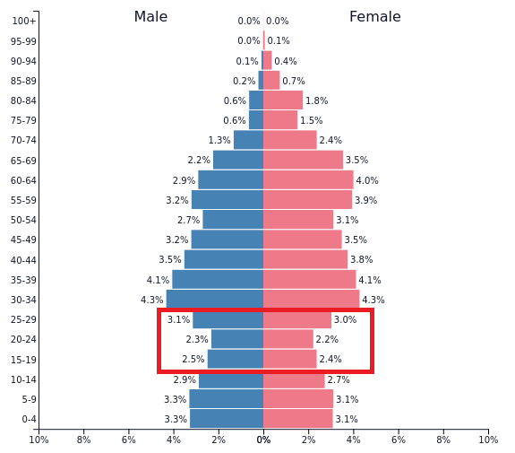
Global Situation Update: April 5, 2022
WHAT WE’RE WATCHING
The Russian military is conducting its annual spring draft and aims to sign up 134,500 conscripts from men age 18 to 27 across the country for a one-year tour of duty. There are approximately 11 million eligible young Russian men (see chart), but the draft presents risks to Russia’s present and future economic situation as well as political blowback from angry youth and parents.
Moscow’s military draft is notoriously riddled with corruption, brutality, and mismanagement. Thousands of young Russian men have already fled the country to avoid conscription. Military analysts around the world are monitoring to see where new conscripts will eventually deploy, and whether Russia continues its retreat towards eastern Ukraine or repositions fresh new troops around Kyiv and southern Ukraine.

Slide 4
Global
The Bucha atrocities have created new momentum in the Western alliance, with allies announcing new political and economic sanctions as well as investigations to document and hold Russia accountable for war crimes.
Ukraine warns that atrocities are likely not limited to Bucha and may be widespread in cities and towns controlled by Russian forces.
Finger pointing for responsibility for the failure to deter Russia has moved into higher gear. Ukrainian President Zelensky is pointing to the 2008 decision to block Ukraine from joining NATO, that left Ukraine vulnerable to Russian aggression.
The US stopped the Russian government from paying holders of Russian bonds more than $600 million from its frozen reserves held in US banks, designed to increase pressure on the Kremlin.
Note: This report is based on sources and information deemed to be true and reliable, but Dentons makes no representations to same.

Slide 5
Markets & Business
JPMorgan has warned that the combination of Russia's war in Ukraine and China's ongoing property crash could see the worst wave of corporate defaults since the global financial crisis. A new report estimated the EM-wide default rate would now reach 8.5 percent, more than double the 3.9 percent they expected at the start of the year before the war in Ukraine.
Mercedes-Benz Group will put more than five thousand workers on collective vacation in two plants in Brazil due to the shortage of semiconductor chips.
Rental car firm Hertz Global Holdings plans to buy up to 65,000 electric vehicles over five years from Swedish EV maker Polestar, the latest move by the rental car firm to add zero-emission models.
Spain's Repsol and Denmark's Orsted are joining up in a bid to develop floating offshore wind in the nascent Spanish market.
JPMorgan could lose about $1 billion on its Russia exposure, per CEO Dimon, detailing the extent of the bank's potential losses from the conflict in Ukraine for the first time.
Note: This report is based on sources and information deemed to be true and reliable, but Dentons makes no representations to same.

Slide 6
Environment, Sustainability & Governance
The World Health Organization released a new report that found 99 percent of the global population breathes air that exceeds the WHO's air-quality limits. Air quality is poorest in WHO's Eastern Mediterranean and Southeast Asia regions, followed by Africa.
A new report by the UN’s climate science panel reiterates findings that efforts above what have been pledged by governments and businesses are necessary to prevent warming from spinning out of control. Concurrently, the UN launched a new High-Level Expert Group tasked with developing standards used to set, measure and track the net zero commitments of non-state entities ranging from businesses and investors to cities and regions.
Toy maker Mattel has released its first mass retail certified carbon neutral toy line including building blocks designed to encourage environmentally conscious behavior.
Thirty-four investors managing more than $7 trillion in assets have warned 17 of Europe's largest companies, including BP and Volkswagen, that they could challenge board directors over their accounting of climate risks.
The EU will raise 6 billion euros ($6.6 billion) from the sale of a new, 20-year green bond today, which will fund member states' environmentally friendly projects that are part of the bloc's COVID-19 recovery fund.
Note: This report is based on sources and information deemed to be true and reliable, but Dentons makes no representations to same.

Slide 7
Africa
South Sudanese officials signed a key section of the 2018 peace
deal; the agreement, which deals with the division of security postings,
was a roadblock to the full implementation of the peace deal.
A Rwandan court upheld a 25-year sentence for Paul Rusesabagina, the Rwandan genocide hero portrayed in “Hotel Rwanda,” on charges of terrorism that international actors have denounced as spurious.
The US and France called on the Malian military junta to allow a UN inquiry into an alleged instance of military violence against civilians.
South Africa’s COVID-19 state of disaster ended at midnight.
The first International Criminal Court proceedings dealing with atrocities in Darfur begin today; suspected Janjaweed militia leader Ali Muhammad Ali Abd-Al-Rahman faces 31 counts of war crimes and crimes against humanity.
Note: This report is based on sources and information deemed to be true and reliable, but Dentons makes no representations to same.

Slide 8
Asia
The Indonesian authorities will distribute a total of 8.8 trillion rupiah
(S$827 million) in cash to low-income workers to help cushion
the impact of rising food and energy prices.
Sri Lankan President Rajapaksa's ruling coalition lost its majority in
parliament on Tuesday after lawmakers walked out of the alliance amid
growing unrest over an economic crisis. The shift left Rajapaksa with a
minority government, which could make decision making more challenging.
Chinese authorities extended the lockdown of Shanghai to cover all of the financial
center's 26 million people after city-wide testing saw new COVID-19 cases surge to more
than 13,000 amid growing public anger over quarantine rules. The city's quarantine policy has
been criticized for separating children from parents and putting asymptomatic cases among those with symptoms. Some public health experts say it is no longer an effective strategy.
Note: This report is based on sources and information deemed to be true and reliable, but Dentons makes no representations to same.

Slide 9
Europe
The US approved the sale of eight F-16 combat aircraft to
Bulgaria for $1.67 billion (€1.52 billion) to improve Bulgaria’s
capability to meet current and future threats.
Serbia's incumbent president, Aleksandar Vucic, has
secured 59.5 percent of votes in a presidential election,
per the State Election Commission, after counting
87.67 percent of ballots.
France's presidential race is tightening ahead of Sunday's first round vote. Opinion polls have long predicted President Macron will win a second term, but far-right challenger Le Pen is closing the gap, with polls showing the 44-year-old president with only a six-point advantage in a likely run-off on April 24.
Note: This report is based on sources and information deemed to be true and reliable, but Dentons makes no representations to same.

Slide 10
How do You Manage Incident Response?
2021 has already seen business disrupted by extreme weather, ransomware attack, the ongoing pandemic and more. The common refrain “It’s not if, but when” rings truer than ever for disruptive incidents that will impact business as usual.
Working with Dentons, you can effectively develop an organizational incident-behavior adopted by all your team members. Dentons will help you build muscle memory through tabletop exercises, which are crafted to fit the business strategy of every client.
Our team plays events and incidents of different severities and complexities and accounts for real-world factors such as inconclusive evidence, mistakes by responders, and the business impact of eradication steps. Our tech-savvy lawyers continuously revise the playbooks per the evolving sector-specific threat landscape.
Dentons tabletop sessions are fluid, and designed to enhance preparedness with services, including:
Ransomware tabletop exercises
Post-tabletop action reports
Maturity assessments for preparedness
Supply-chain attack simulation
Comprehensive incident response plan
Threat analysis and monitoring
All interaction with Dentons is attorney-client privileged
To learn more about the bespoke intelligence and risk services from Dentons, contact Karl Hopkins.

Slide 11
Middle East
The first fuel shipments in months entered Yemen’s
Houthi-controlled port of Hodeidah as the Ramadan truce
took effect; the Saudi-led coalition has maintained a blockade
on the port for years due to arms trade concerns.
At a press conference with his Russian counterpart, Egypt’s foreign
minister offered that Arab countries could mediate between Russia and
Ukraine.
A top World Bank official reiterated that the Middle East and North Africa
region is in a “critical” food security situation amid the conflict in Europe.
A Lebanese prosecutor has reportedly sought to freeze European assets owned the central bank governor, the subject of her months-long corruption probe.
Note: This report is based on sources and information deemed to be true and reliable, but Dentons makes no representations to same.

Slide 12
Americas
A former Colombian soldier pleaded not guilty on US charges that he conspired to assassinate Haitian President Moise.
New polls show that more Chileans now oppose approving a new constitution than support it; the text, which is still being drafted and will face a referendum later this year, was put in place during the Pinochet era and is seen by critics as facilitating economic inequality.
The Ecuadorian government retook control of a Cuenca prison where fights between rival gangs killed 20 over the weekend.
Pope Francis's long-awaited apology to Canada's indigenous community for more than a century of abusive residential schools, many of them run by the Catholic Church, should be followed by millions of dollars in compensation and the release of residential school records, survivors and indigenous leaders said.
Note: This report is based on sources and information deemed to be true and reliable, but Dentons makes no representations to same.

Slide 13
Americas: US
Amid confusion over whether Americans should seek an additional booster shot, the FDA’s expert advisers will discuss the timing of additional COVID-19 vaccine boosters and the people eligible for the extra shots in a meeting later this week.
The Biden Administration urged Congress to move quickly on $10 billion in funding for COVID aid after bipartisan agreement was reached yesterday, a sum that is less than the $22.5 billion the administration wanted.
US Supreme Court nominee Ketanji Brown Jackson secured the support of two more Senate Republicans yesterday, as she cleared a procedural hurdle toward becoming the first Black woman to serve on the nation's top judicial body.
US trade chief Katherine Tai clarified that the US is seeking to realign its commercial ties with China rather than seek a "divorce" between the world's biggest economies.
Note: This report is based on sources and information deemed to be true and reliable, but Dentons makes no representations to same.

Slide 14
Conflict Update: 2022 Hotspots in North Africa and the Horn
By Matthew Skros
Ethiopia
The civil war in Ethiopia between the federal government in Addis Ababa and the Tigrayan People’s Liberation Front (TPLF) is into its 16th month. What began as a back-and-forth battle between the national military and rebel forces is now a stalemate as a humanitarian crisis grips the Tigray region. The federal government declared a unilateral truce on March 24 to facilitate the delivery of aid to Tigray, which was largely cut off for many months. The Tigrayan regional government pledged to respect that ceasefire if aid was delivered expediently. Lasting peace, though, is far from assured, especially considering that neither side has disclosed details of the ceasefire nor how aid will reach the stricken region. Moreover, reported skirmishes between Tigrayan rebels and government forces in the Afar region (which borders Tigray) raises the possibility that this conflict may further expand throughout Ethiopia, or spill into neighboring countries. If the Tigrayan rebels remain determined to carry the fight outside of their own territory, this could significantly hamper any chances of peace talks. Instability will remain high in Ethiopia for the foreseeable future, barring a significant diplomatic breakthrough.
Somalia
Terrorist attacks are increasing concurrently with rising tensions between Somalia’s president and prime minister. While the two struck a deal in October 2021 to hold long-delayed elections, President Mohamed Abdullahi Mohamed later suspended the powers of
While world attention is consumed with the war in Ukraine, armed conflicts are raging in Africa. In Ethiopia, a serious humanitarian crisis is the result of over a year of war between Tigrayan rebels and the federal government. In Somalia, Salafi-jihadist group al-Shabaab continues to launch attacks as a political impasse grips the country. In Libya, rival governments in Tobruk and Tripoli risk unraveling a 2020 ceasefire agreement. All three hot spots have the potential to flare up in 2022, causing instability and posing a significant risk to human and business interests in those countries.
Note: This report is based on sources and information deemed to be true and reliable, but Dentons makes no representations to same.

Slide 15
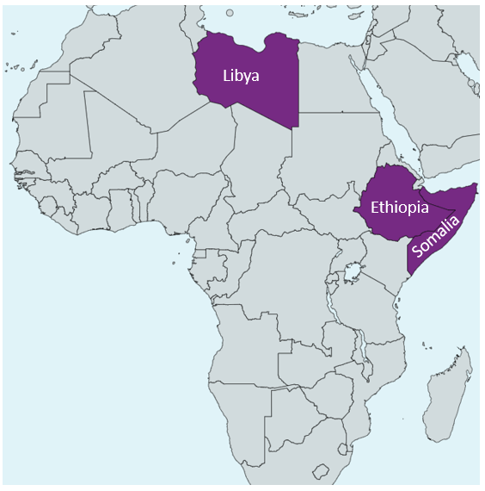
Conflict Update: 2022 Hotspots in North Africa and the Horn
of Prime Minister Mohamed Hussein Roble in December 2021. Mohamed claimed he did so because Roble is corrupt, but the ousted prime minister claimed that his suspension was an attempted coup. On March 16, the Somali electoral committee announced that the deadline for completing long-delayed elections to the Lower House of parliament would be pushed back again, this time to March 31. However, only three of Somalia’s five states had selected their representatives by the March 15 deadline. At the same time as these elections were being held, al-Shabaab launched attacks on election venues seeking to disrupt the process. A twin suicide attack in Beledweyne city killed 48, including a sitting MP. On that same day, al-Shabaab raided the Mogadishu airport, killing six people including five foreign nationals. The political impasse at the national level hampers the government’s ability to respond robustly to the terrorist threat. Without a unified front against the long running jihadist insurgency, the risk of deadly conflict in Somalia will remain high until a political solution is achieved.
Libya
On March 1, the Tobruk-based House of Representatives (HoR) voted to support the government of Prime Minister Fathi Bashagha,
Note: This report is based on sources and information deemed to be true and reliable, but Dentons makes no representations to same.

Slide 16
Conflict Update: 2022 Hotspots in North Africa and the Horn
who then vowed to install his government in the capital of Tripoli. In Tripoli, incumbent Prime Minister Abdul Hamid Dbeibeh condemned the HoR vote as fraudulent and refused to give up power to Bashagha. Over the past month, there have been several confrontations between armed militias loyal to the two governments, raising the possibility of full-scale open war. UN officials have attempted to bring the two sides together to resolve the impasse, but to no avail thus far. Bashagha vows to enter Tripoli in the next few days, meaning clashes could occur soon between the rivaling factions. In an oil-rich nation like Libya, maneuvering militias and parallel governments have already led to a decrease in oil production. With the global oil markets already being shaken by the war in Ukraine, instability in Libya will further disrupt that market.
Ukraine and Africa
The war in Ukraine’s impact on global food supplies will negatively affect conditions in these three countries, leading to further food insecurity. Russian and Ukrainian wheat imports combined make up 40 percent of Ethiopia’s supply, with most of that percentage coming from Ukraine. For Libya and Somalia, those numbers are 60 and 90 percent respectively, with the majority of both import percentages also coming from Ukraine. For the Horn of Africa countries (Ethiopia and Somalia) this crisis will be especially acute as a severe drought is projected to affect those countries for the first half of 2022. As food staples become scarce, leaders will face an increasingly restive population. Adverse economic conditions could drive more people to join extremist organizations or rebel groups. Humanitarian aid agencies will also find their budgets stretched as foodstuffs become more expensive, leading to some possible programmatic cutbacks and an inability to meet human needs. Moreover, even if the war in Ukraine were to end tomorrow, food supply issues could take years to resolve themselves. Hot conflicts in Africa compounded with economic woes will drive further instability and worsen already simmering crises.
Note: This report is based on sources and information deemed to be true and reliable, but Dentons makes no representations to same.

Slide 17
Ukraine War Update: War Crimes, Finger Pointing, Frozen Reserves
The Bucha atrocities have created new momentum in the Western alliance, with allies announcing new political and economic sanctions as well as investigations to document and hold Russia accountable for war crimes.
Political Developments
Satellite images released by Maxar Technologies on April 4, 2022 show views of streets in Bucha taken on March 31, with bodies lying in the streets, before Russian forces retreated from the town.
Western countries are turning their outrage at the Bucha atrocities into action. The EU's foreign policy chief Borrell said that "the Russian authorities are responsible for these atrocities, committed while they had effective control of the area. They are subject to the international law of occupation.” European Commission President Ursula von der Leyen said the EU was ready to send investigators to probe possible war crimes.
The US plans to ask the UN General Assembly to suspend Russia from its position on the Human Rights Council. Russia is in its second term out of three sitting in the Geneva-based council. A two-thirds majority vote can oust any member for systemic violations of human rights.
Germany expelled 40 Russian diplomats as “undesirable persons,” and France announced its intention to do the same. Denmark will expel 15 Russian diplomats for spying. Italy expelled 30 diplomats for “security concerns.”
Russia continued to deny responsibility for the civilian killings, calling the images “fake.” Russian Deputy Chairman of Russia’s Security Council threated that Moscow would respond harshly to the expulsions.
US President Biden once again called Russian President Putin as “war criminal,” while pledging additional sanctions.
Ukrainian President Zelenskyy will address the UN Security Council today during a session to consider Ukrainian allegations of a
Note: This report is based on sources and information deemed to be true and reliable, but Dentons makes no representations to same.

Slide 18
Ukraine War Update: War Crimes, Finger Pointing, Frozen Reserves
massacre of civilians at Bucha by Russian forces. Zelenskyy said in an address to Romania's parliament yesterday that the number of civilian casualties in towns such as Borodyanka may be even higher than in Bucha.
Finger pointing for responsibility for the failure to deter Russia has moved into higher gear. Ukrainian President Zelensky charged that the 2008 decision to block Ukraine from joining NATO, led by former German Chancellor Angela Merkel and France's former President Nicolas Sarkozy, left Ukraine vulnerable to Russian aggression. Merkel issued a statement defending her 2008 position. German President Frank-Walter Steinmeier, who served twice as ex-Chancellor Angela Merkel’s foreign minister, acknowledged that Germany should have taken the warnings of eastern European partners more seriously, particularly after 2014.
President Zelensky acknowledged that holding more talks with Russia was very challenging after the discovery of the Bucha atrocities, but there was no other option. He judged that a face-to-face meeting between him and Russian President Putin does not look likely.
China's Foreign Minister Wang Yi spoke with Ukrainian Foreign Minister Dmytro Kuleba, in a phone call yesterday, with Beijing again calling on talks to end the conflict in Ukraine while declining to condemn Russia’s invasion of Ukraine.
Battlefield Developments
The US Defense Department confirmed that Russian forces are responsible for the atrocities at Bucha but has not disclosed an assessment of which Russian units were responsible.
The Ukrainian army continues to clear the Kyiv area of explosive devices left behind by withdrawing Russian troops. The Kyiv mayor urged residents not to return for at least a week. A 24-hour curfew remains in place in some districts.
Russian troops have departed the region of Sumy, according to the governor. Suny, on the border with Belarus, has been occupied for a month. Russian forces left behind “lots of military equipment.”
Russian forces continued to shell the southern city of Mykolaiv. Additionally, Ukraine's Defense Ministry said that Russia is preparing
Note: This report is based on sources and information deemed to be true and reliable, but Dentons makes no representations to same.

Slide 19
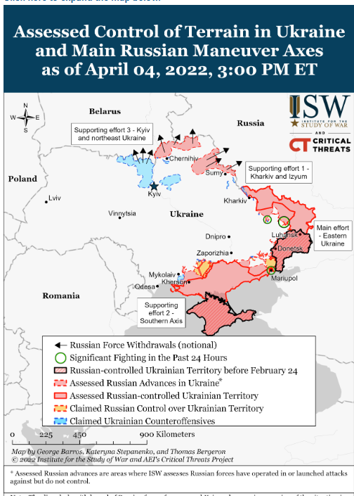
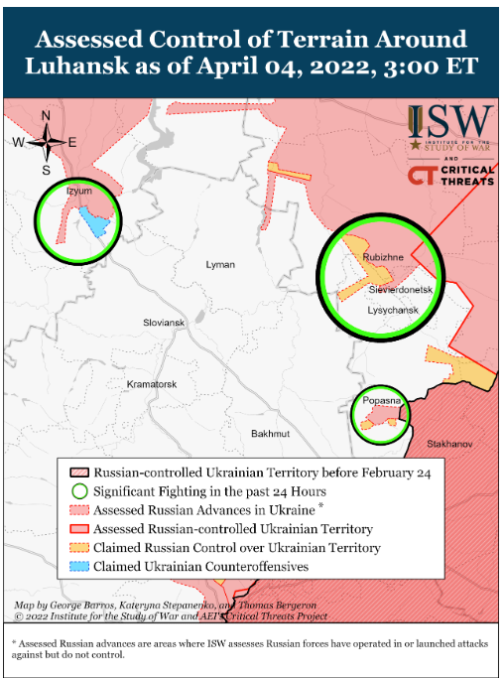
Ukraine War Update: War Crimes, Finger Pointing, Frozen Reserves
to launch new attacks in eastern Ukraine and take the northeastern city of Kharkiv. Russia was attacking the towns of Rubizhne and Popasna in the Luhansk region. The governor of Luhansk urged civilians to evacuate immediately.
According to analysis by the Institute for the Study of War (ISW), efforts by Russian forces advancing from Izyum to capture Slovyansk will likely prove to be the next pivotal battle of the war in Ukraine. Russian forces advancing from the Kharkiv axis are setting conditions to resume offensive operations through the city of Slovyansk to link up with other Russian forces in Donbas and encircle Ukrainian defenders. Russian forces captured Izyum (southeast of Kharkiv)
Source: Institute for the Study of War
Note: This report is based on sources and information deemed to be true and reliable, but Dentons makes no representations to same.

Slide 20
Ukraine War Update: War Crimes, Finger Pointing, Frozen Reserves
on April 1 and have conducted active preparations to resume offensive operations for the past three days—stockpiling supplies, refitting damaged units, repairing the damaged bridge in Izyum, and conducting reconnaissance in force missions toward the southeast. Russian forces will likely begin offensive operations towards Slovyansk, 50km southeast of Izyum, in the coming days.
UK's Ministry of Defense assessed that Russia is consolidating its position in the eastern Donbas region of Ukraine, parts of which have been under the control of Russian-backed separatists since 2014. Soldiers from the Wagner mercenary group were being deployed in the eastern region. British military intelligence said Russian forces would need "significant re-equipping and refurbishment" before they could be redeployed in Ukraine.
ISW analysts assess that Russian forces in Donetsk and Luhansk Oblasts continue to make little to no progress and face mounting casualties and declining morale. Replacements and reinforcements from northeastern Ukraine are highly unlikely to meaningfully change the balance of forces.
Humanitarian Developments
Speaking on conditions in the Kyiv suburbs of Bucha and Irpin, the International Committee of the Red Cross (ICRC) described situations of “utter desolation and destruction.” Entire civilian neighborhoods are destroyed beyond repair. Streets are littered with unexploded remnants of war. There are still places that are heavily mined and are extremely dangerous. The ICRC is unable to send trucks with humanitarian supplies until the roads are cleared.
Ukrainian Deputy Prime Minister Vereshchuk said seven humanitarian corridors were to open today from Mariupol and Berdyansk, and that more than 1,550 civilians were evacuated from Mariupol on Monday.
Economic Developments
The US stopped the Russian government from paying holders of Russian bonds more than $600 million from its reserves held in US banks. Previously, the US had allowed Russia to access its frozen foreign reserves on a case-by-case basis to make coupon payments. "Russia must choose between draining remaining valuable dollar
Note: This report is based on sources and information deemed to be true and reliable, but Dentons makes no representations to same.

Slide 21
Ukraine War Update: War Crimes, Finger Pointing, Frozen Reserves
reserves or new revenue coming in, or default," a US Treasury spokesperson said.
The German government has taken temporary control of the German subsidiary of Russian state-owned energy giant Gazprom. Last week, Gazprom announced that it was separating from its Gazprom Germania subsidiary, having previously been the sole owner. It did not make clear whether the organization had been sold, or who it planned to leave in control. German officials said that the company controlled critical infrastructure in Germany and that the lack of clarity over its ownership led to the temporary step. The state regulator for electricity and gas is scheduled to control the company until the end of September.
Italy plans to conclude its first deals to purchase more gas from suppliers to replace flows from Russia soon. Italy expects to receive an extra 10 billion cubic meters (bcm) of gas from pipelines to Algeria, Libya and Azerbaijan this year.
Australia's Foreign Ministry announced that it would ban the export of luxury goods to Russia.
Home rental company Airbnb Inc said late yesterday it had suspended operations in Russia and Belarus.
Note: This report is based on sources and information deemed to be true and reliable, but Dentons makes no representations to same.

Slide 22
Coronavirus Condition Updates
As of 8:11 pm CEST on April 4, 2022

Slide 23
Confirmed Cases (New)
Europe
204,071,645 (288,854)
Eastern Med
21,595,806 (9,393)
Western Pacific
47,380,282 (361,152)
Americas
150,921,301 (29,873)
Southeast Asia
57,223,740 (27,988)
Africa
8,585,524 (1,034)
Cruise Ships
721 (0)
Global: 489,779,062 (718,294)
Reflects data as of 8:11 pm CEST on April 4, 2022.
Data Source: World Health Organization

Slide 24
Total Deaths (New)
Europe
1,944,195 (683)
Eastern Med
340,860 (121)
Western Pacific
213,461 (506)
Americas
2,702,800 (272)
Southeast Asia
779,646 (171)
Africa
171,120 (5)
Cruise Ships
15 (0)
Global: 6,152,095 (1,758)
Reflects data as of 8:11 pm CEST on April 4, 2022.
Data Source: World Health Organization

Slide 25
Contacts
This summary is based on reports sourced from among the 75 countries in which Dentons currently serves clients as well as from firms in other locations, some of which will formally join Dentons later in 2020. We are pleased to share this complimentary summary and contemporaneous assessment, with the caveat that developments are changing rapidly. This is not legal advice, and you should not act or refrain from acting based solely on its contents. We urge you to consult with counsel regarding your particular circumstances.
To read additional analysis, visit the Dentons Flashpoint portal for insights into geopolitics and governance; industry and markets; cyber and security; science, health and culture; and economic and regulatory issues.
Karl Hopkins
Partner and Global Chief Security Officer
Dentons
Washington, DC
D +1 202 408 9225
karl.hopkins@dentons.com
Melissa Mahle
Senior Analyst
Dentons
Washington, DC
D +1 202 408 6383
melissa.mahle@dentons.com

